Slide 1
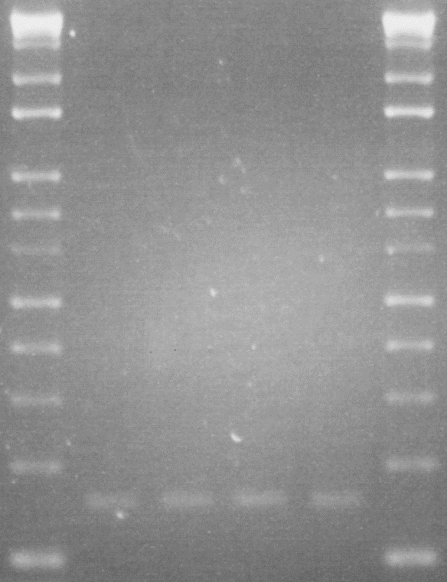
Supplementary Fig. 1.
200 bp
100 bp
AA AG AG GG
rs7636910
Exon 7
Exon 8
Exon 9
(a)
(b)
(a) + (b) = 162 bp

Slide 2
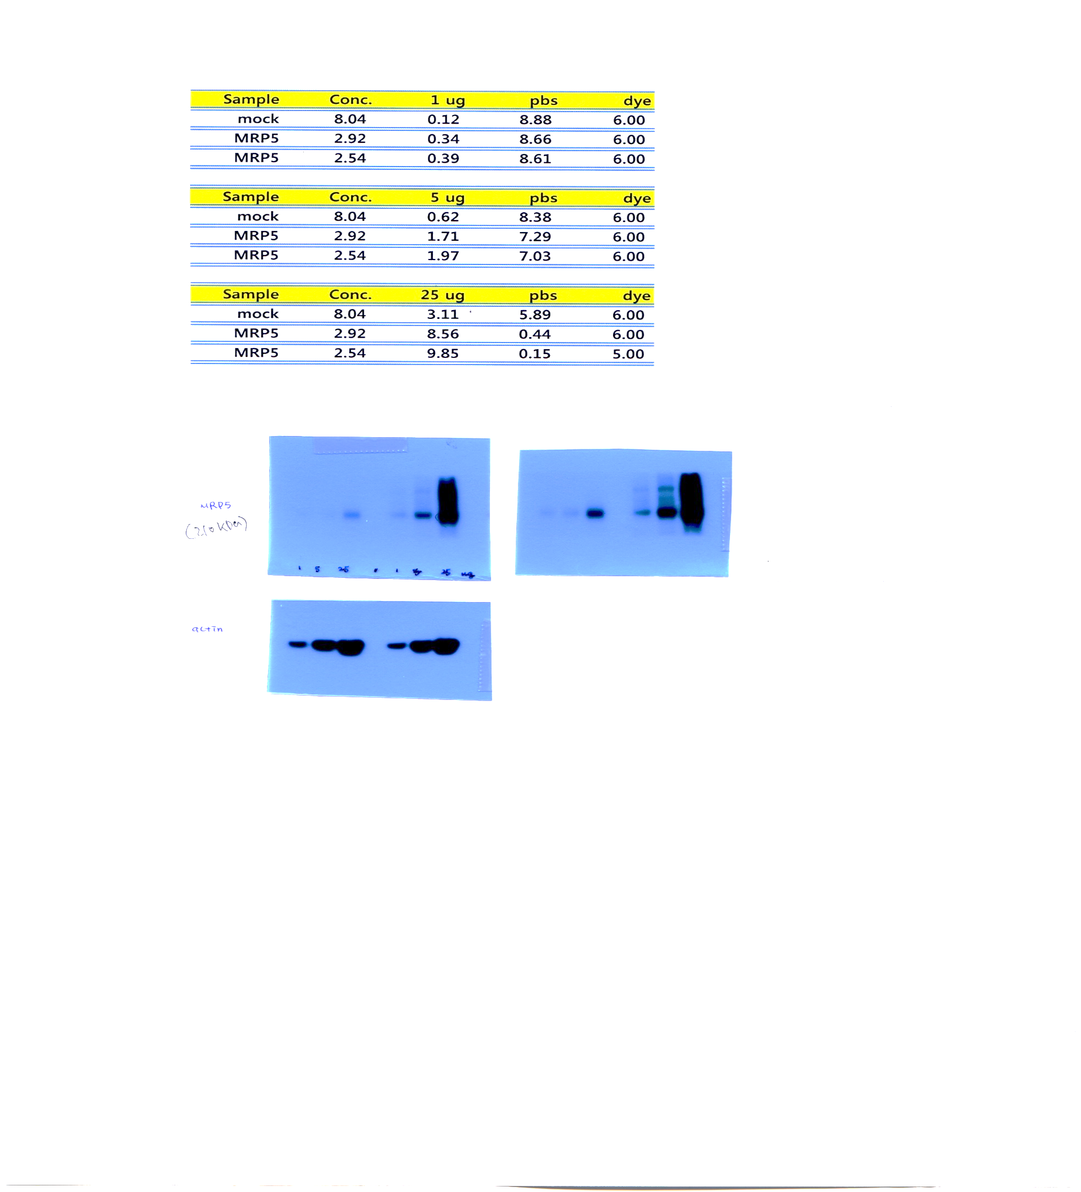
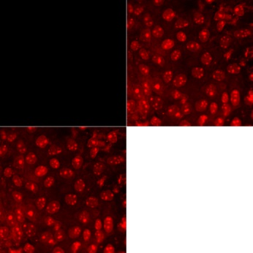

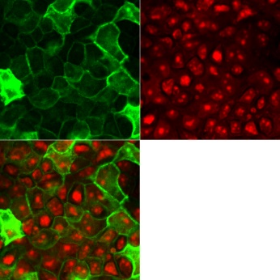
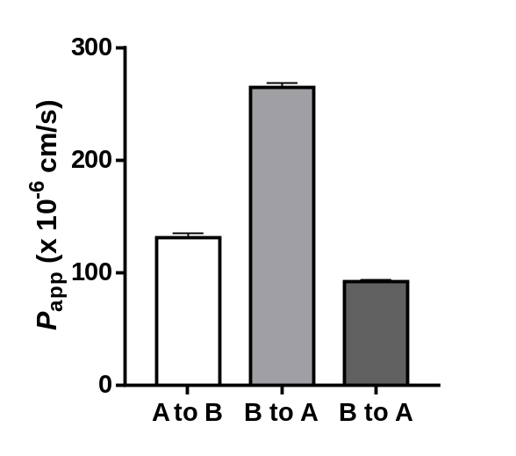
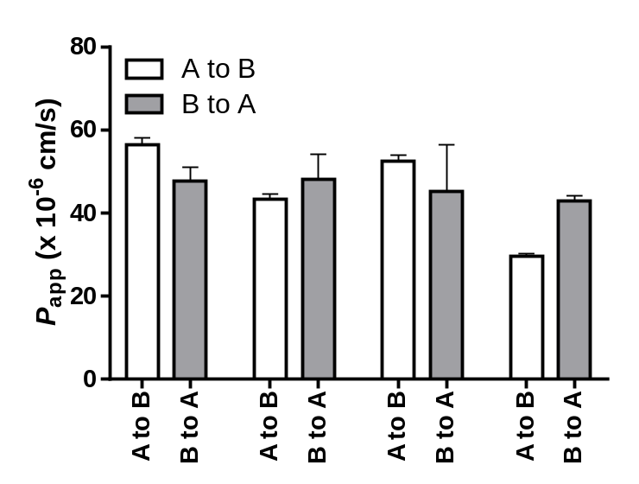
Supplementary Fig. 2.
A
MDCKII
MDCKII-MRP5
B
MDCKII
MRP5
MRP5
Nuclei
Merge
β-actin
Protein loading amount
1 5 25
1 5 25 μg
MDCKII-MRP5
C
D
10 30 60 100 μM Cilostazol
(+ MK571
100 μM)
1 μM Carboxydichlorofluorescein

Slide 3
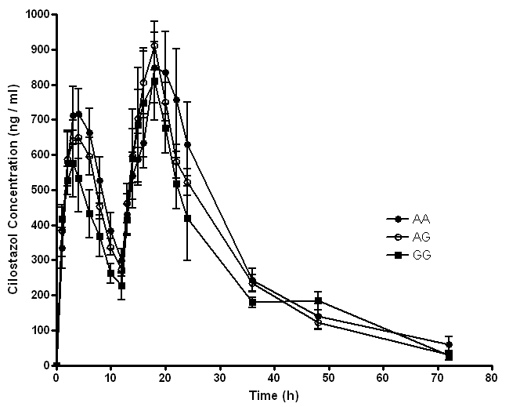
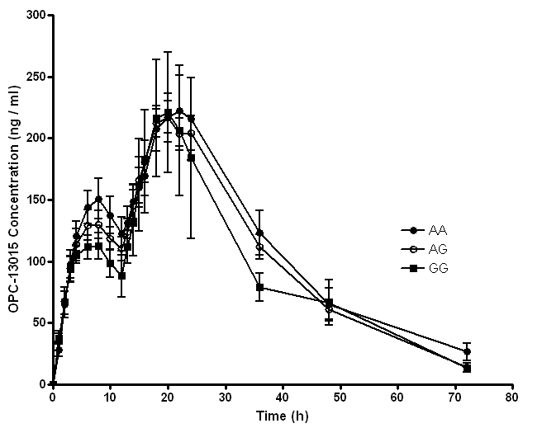
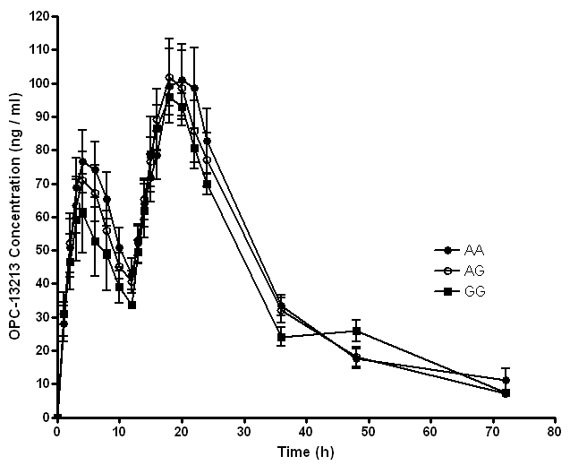
Supplementary Fig. 3.
A
B
C

